Slide 1
EMT Just In Time Training Modules, COVID-19
Personal Protective Equipment for COVID

Slide 2
Session Outcomes
Identify which PPE items and procedures are recommended for EMT staff in different clinical settings
Outline effective practices for putting on and removing PPE in COVID treatment facilities
Outline the options for adapting PPE routines within the EMT, based on inventory

Slide 3
Group Analysis
For each of these clinical settings, which PPE items & procedures are recommended for EMT staff to use? Draw the items on your stick figure.
Preliminary screening / triage in inpatient facilities, not involving direct context
Inpatient ward for COVID patients (no aerosol generating procedures)
Inpatient ward for COVID patients (where aerosol generating procedures are frequently used)
Outpatient consultation room for physical examination of suspected COVID patients

Slide 4
Group Analysis
Please now review the relevant sections of Table 1 in the written handout provided
Consider the operational roles that your EMT is engaged in.
Are there any instances where the generic guidance on PPE may need to be adapted to fit your context? Discuss in teams & list on your charts.

Slide 5
Decision Making Considerations when Faced with PPE Shortages
‘Whole of society approach’ is required
Importance of evidence base & guiding principles
Last resort temporary measures may include:
PPE extended use
Reprocessing followed by reuse
Considering alternative items to those in WHO standards
Use of PPE items beyond their expiration date
Discuss whether and how these considerations may apply, given the PPE resources available to the EMT

Slide 6
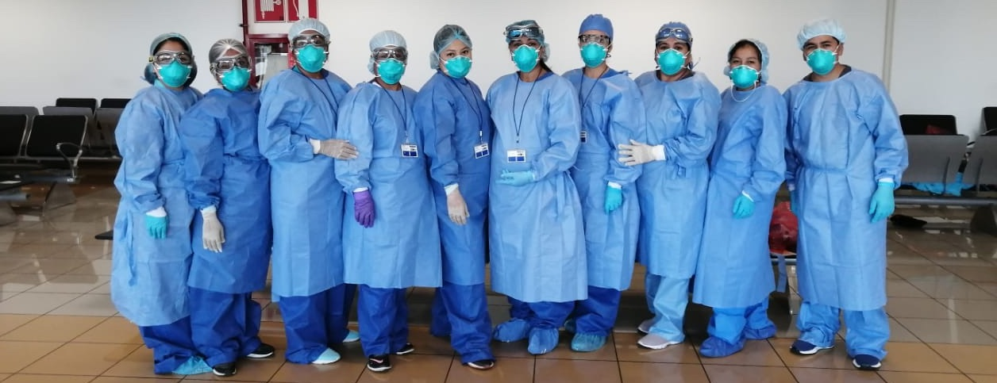
Time to Practice!

Slide 7
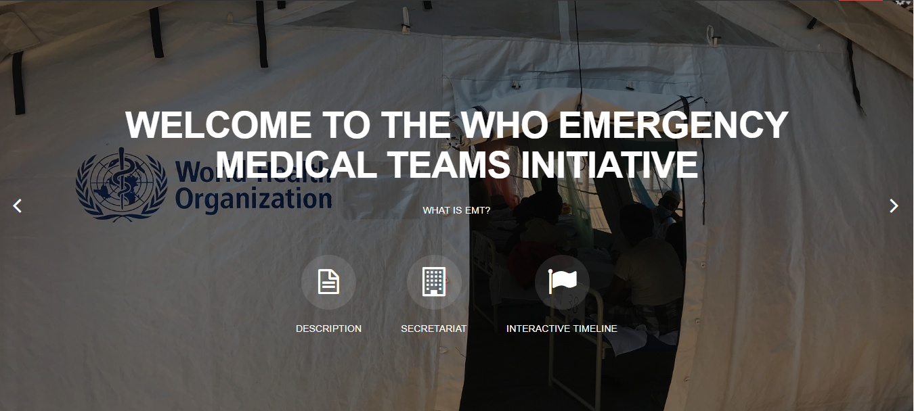
Thank you
Any questions?
For more…
http://extranet.who.int/emt/
EMTeams@who.int

